Slide 1


Slide 2
JAVA OOPS PROJECT
PROJECT NAME: Simple ATM Machine Simulator
PRESENTED BY –Madhav Kumar
Ankit Raj
Avinash Kumar

Slide 3
PROJECT TITLE :Simple ATM Machine Simulator
Description:
This project simulates a basic ATM system using Java and Object-Oriented Programming (OOP).
It allows a user to perform simple banking operations such as checking balance, depositing money, and withdrawing money.
The system handles basic validations like checking for sufficient balance during withdrawal....
It uses an Account class to encapsulate user account details and methods, and a main() method to simulate ATM transactions.
It’s ideal for beginners to practice class structure, method creation, and object manipulation in Java.

Slide 4
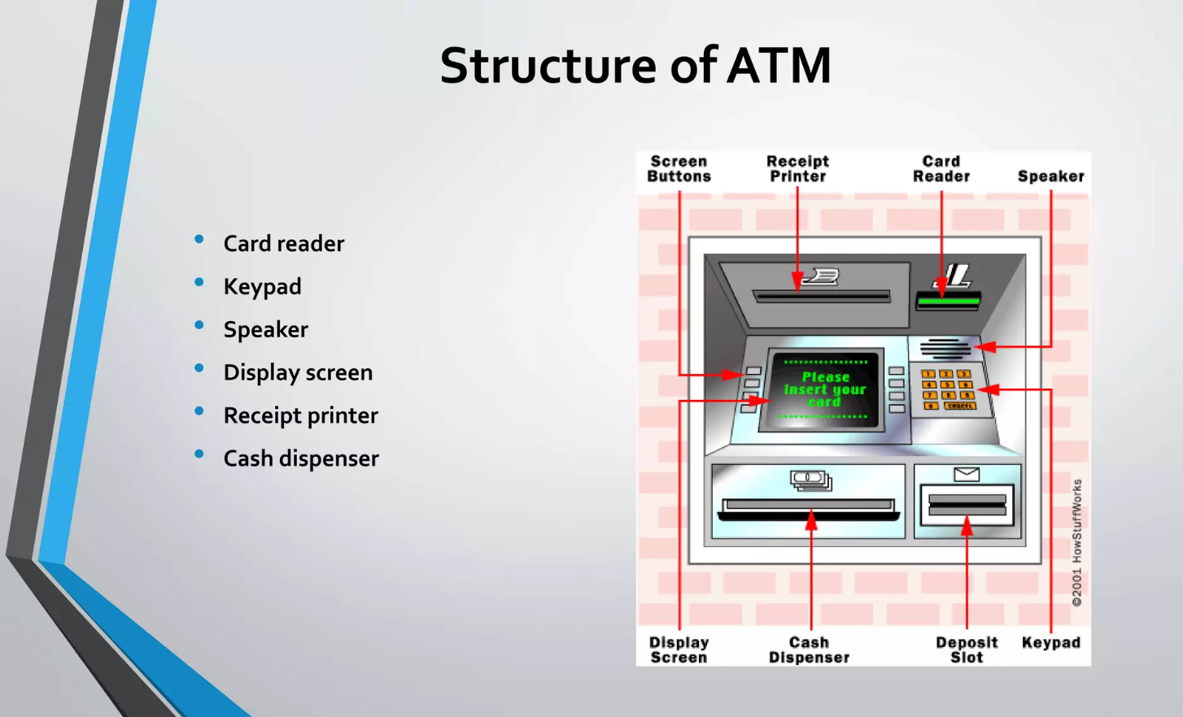

Slide 5
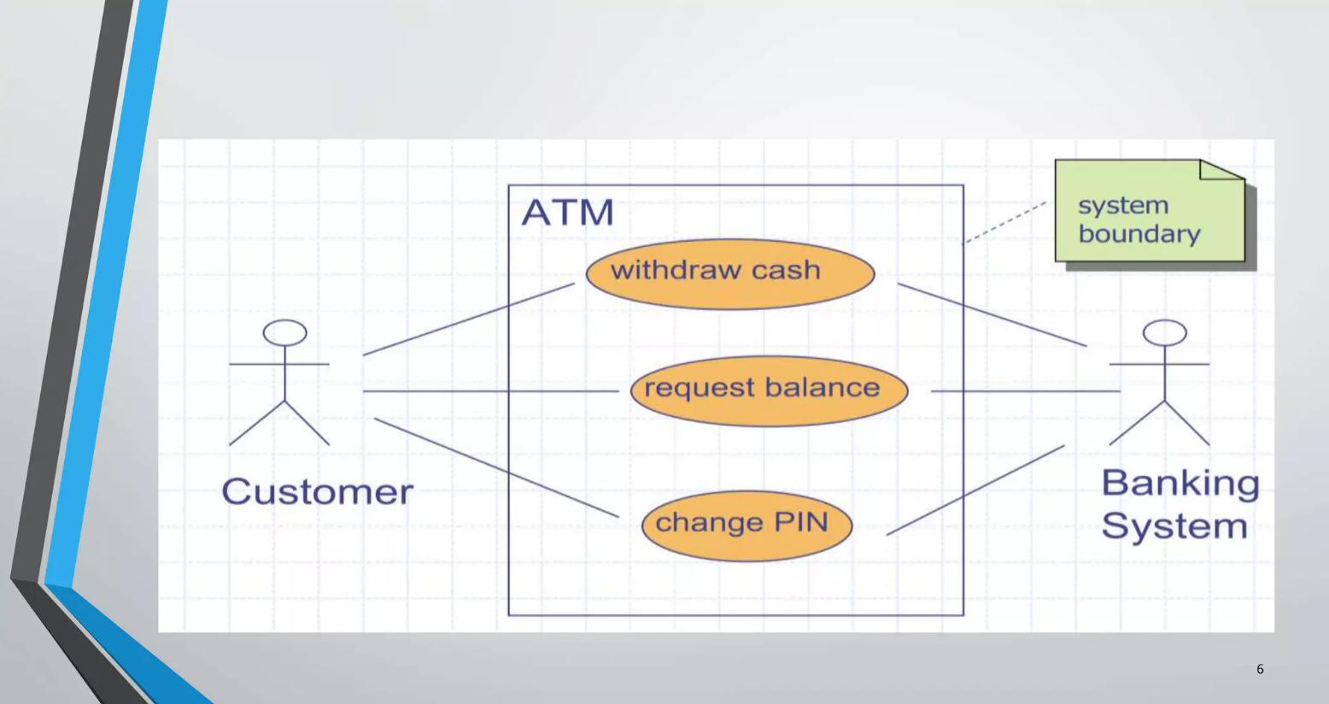

Slide 6
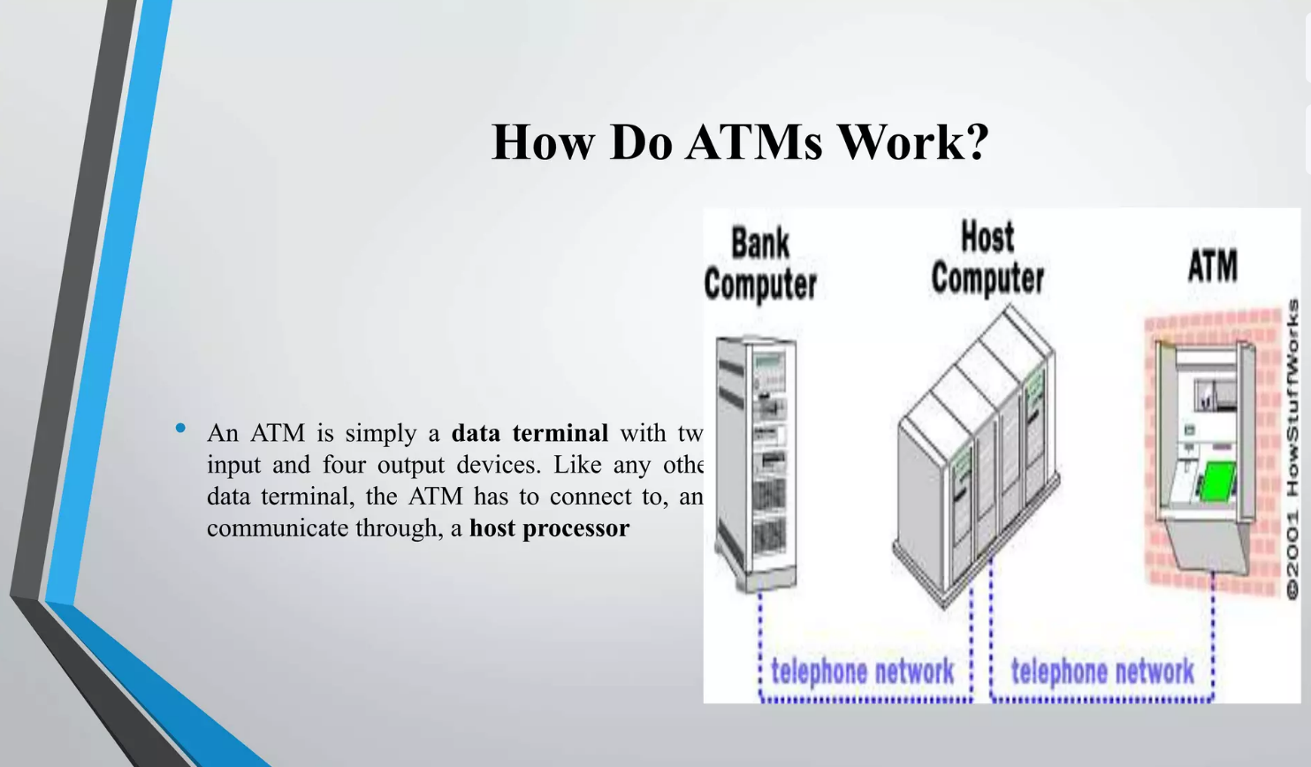

Slide 7
Java Project code
import java.util.*;
class Account {
String user; int balance;
Account(String user, int balance) { this.user = user; this.balance = balance; }
void deposit(int amount) {
balance += amount;
System.out.println("Deposited: " + amount);
}
void withdraw(int amount) {
if (balance >= amount) {
balance -= amount;
System.out.println("Withdrawn: " + amount);
} else System.out.println("Insufficient funds.");
}
void showBalance() {
System.out.println(user + "'s Balance: " + balance);
}
}

Slide 8
Java Project code
public class ATMSystem {
public static void main(String[] args) {
Scanner sc = new Scanner(System.in);
Account acc = new Account("John", 1000);
acc.showBalance();
acc.deposit(500);
acc.withdraw(300);
acc.withdraw(1500);
acc.showBalance();
}

Slide 9
Thank You

